Slide 1
Project Earworm
Trevor Howat: SWENG-861

Slide 2
Agenda
Project Outline
Design and Process
Challenges and Opportunities
Demonstration

Slide 3
Project Outline
Earworm: A catchy tune that gets stuck in your head
Software allows users to look up Songs and Artists using Spotify’s music library
Displays the results in an easy to read table

Slide 4
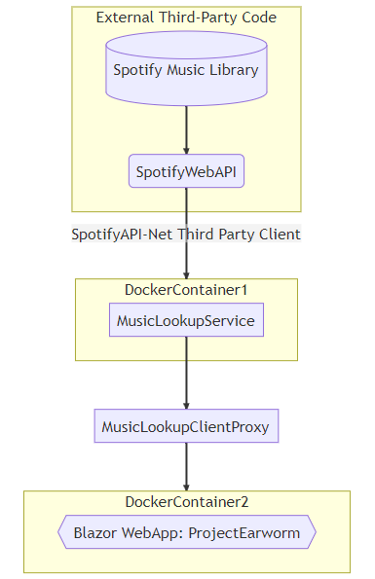
Design and Process
Tools:
Backend is written in .NET (C#)
Frontend is Blazor
Backend service calls the SpotifyWebAPI
A helper library called SpotifyAPI-NET is used to make the calls.
Tests are written using NUnit Standards
Service and Web UI are deployed on Docker
Github is used for Version Control

Slide 5
Challenges and Opportunities
Difficulties with Docker
Stretch goals were not reached
Tests could be more robust
Frontend is not the prettiest
Opportunities:
Search for albums
CI/CD Pipeline
Configuration
More detailed responses

Slide 6
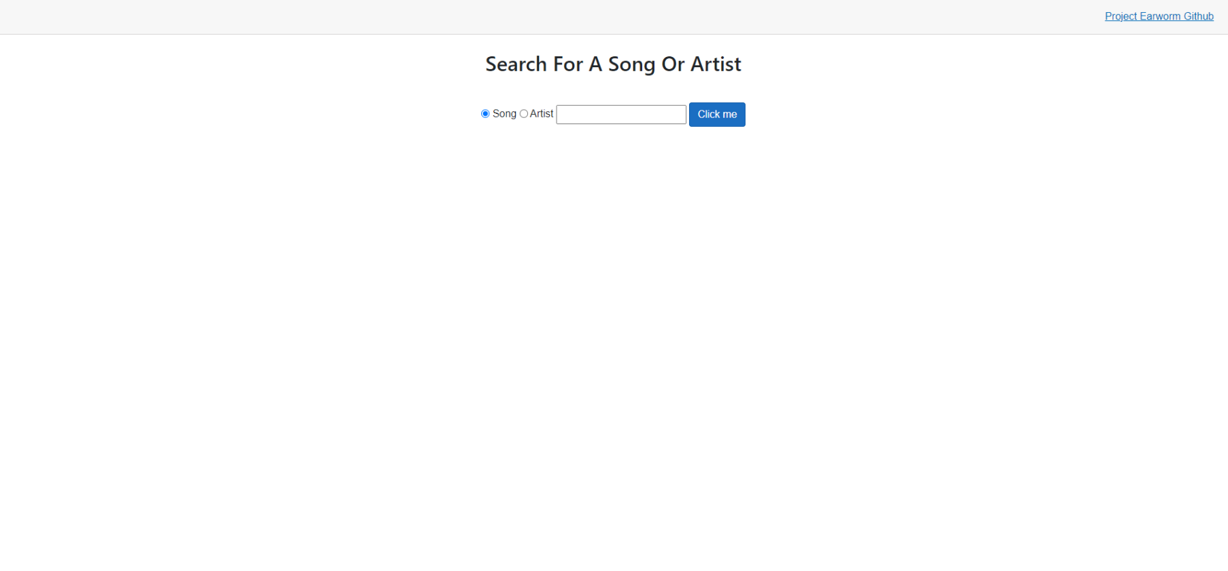
Demo!

Slide 7
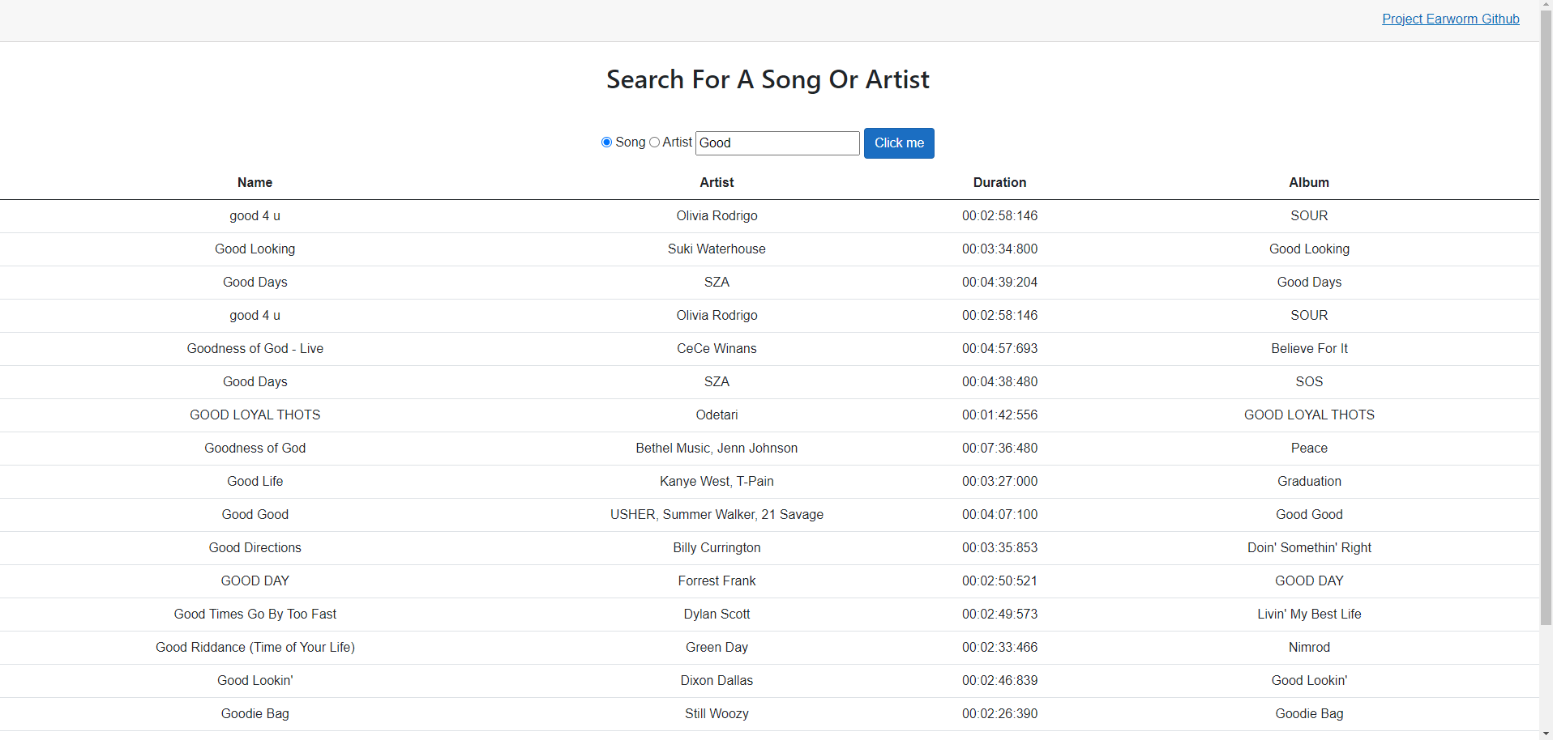
Demo: Song Search

Slide 8
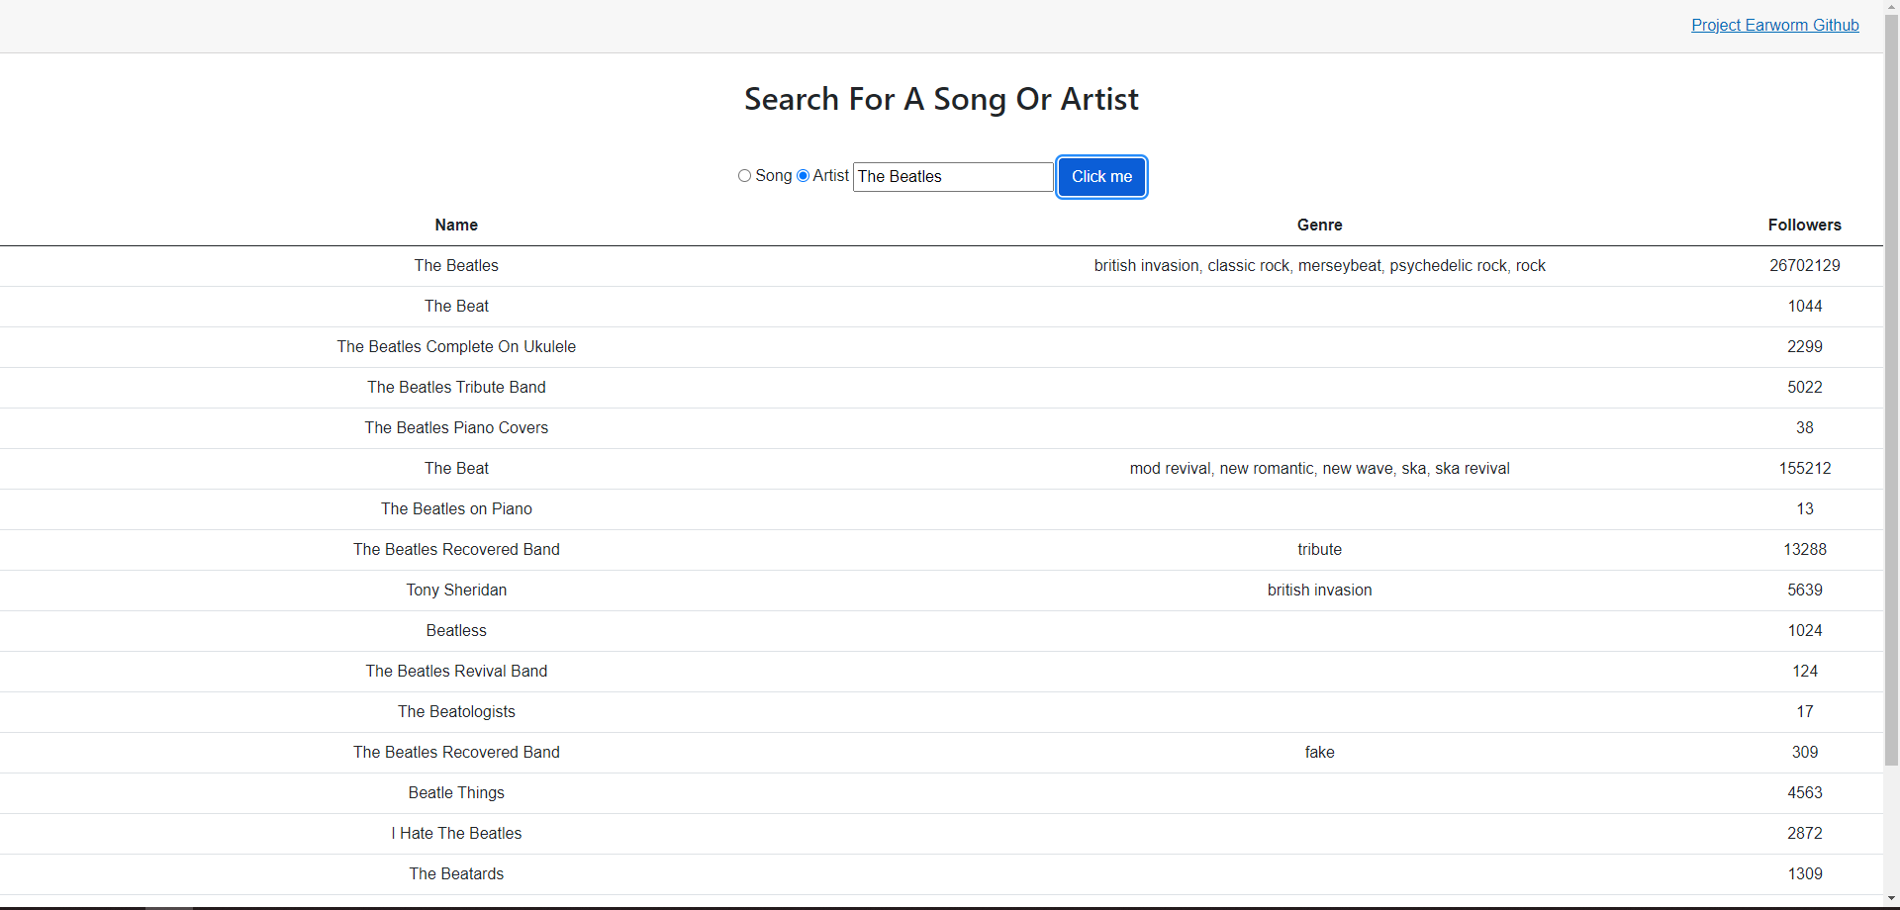
Demo: Artist Search

Slide 9
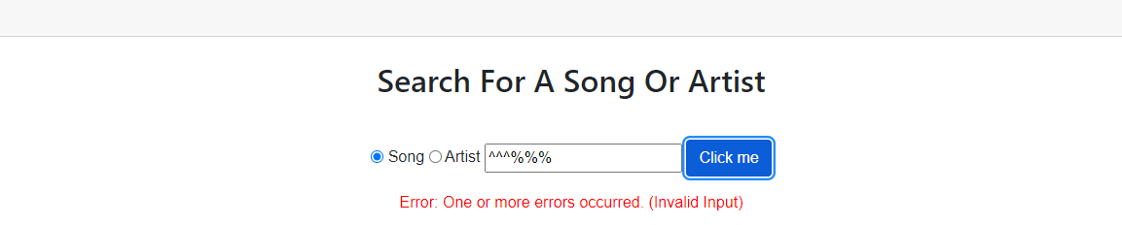
Demo: Bad Input

Slide 10
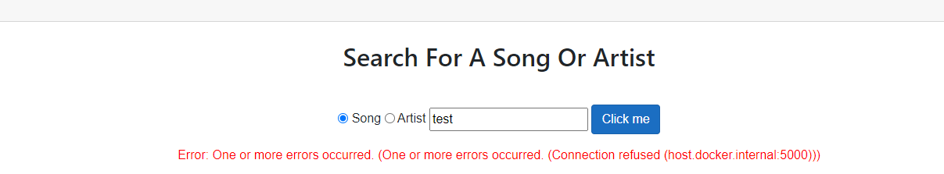
Demo: Service Error

Slide 11
Thank you!

